Slide 1
ROS-Related Communication in Regulation and Signaling
by 周熠家
from
Intracellular Redox Compartmentation and ROS-Related Communication in Regulation and Signaling
Recent Progress in Understanding the Role of Reactive Oxygen Species in Plant Cell Signaling

Slide 2
How can a ROS make influence on signaling?
Production
Defense
Sensing
Transport
Et al.

Slide 3
How can a ROS make influence on signaling?
Production
Defense
Sensing
Transport
Et al.

Slide 4
Production
highly redox-active powerhouses such as chloroplasts, peroxisomes, and mitochondria
- Because of their high capacity for ROS generation, it is often assumed that these organelles can accumulate high ROS levels. If this does occur, the resulting oxidative events will prohibit the classical functions of these organelles.
plasmalemma and apoplast cell wall compartment
-many basic processes involved in cell wall growth and dynamics require a highly oxidizing environment
-the apoplast has evolved a relatively low capacity for antioxidant accumulation, together with enzymes that actively remove these compounds

Slide 5
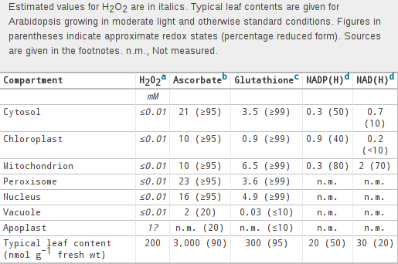
Production, or Concentration

Slide 6
Production, or Concentration
ascorbate is highly reduced in all compartments apart from the vacuole and apoplast
the reduction state is very high in many compartments, with most of the GSSG present in the vacuole or apoplast
pyridine nucleotide pools are at more reduced states in the mitochondria than in the cytosol and chloroplast.
Relatively oxidized pools of NAD and NADP are probably required for the operation of glycolysis in the cytosol and the photosynthetic electron transport chain in the chloroplast.

Slide 7
How can a ROS make influence on signaling?
Production
Defense
Sensing
Transport
Et al.

Slide 8
Defense
In chloroplasts, ascorbate peroxidases (APXs) and 2-Cys peroxiredoxins are the front-line defenses against H2O2 accumulation.
Other compartments such as the mitochondria, peroxisomes, and cytosol contain APX. The reducing substrates required by these antioxidative peroxidases are supplied by several systems that depend on ferredoxin, NAD(P)H, and glutathione.

Slide 9
antioxidants could play roles in transmitting ROS signaling
an antioxidant is defined as a compound that outcompetes others in reacting with ROS to give a relatively stable oxidized product
supported by direct analysis of the roles of thiol compounds such as glutathione in signaling triggered by H2O2.
Other thiol-based antioxidants such as peroxiredoxins, thioredoxins, and glutaredoxins are likely to be involved in ROS signaling cascades, perhaps in a similar way to processes occurring in yeast

Slide 10
How can a ROS make influence on signaling?
Production
Defense
Sensing
Transport
Et al.

Slide 11
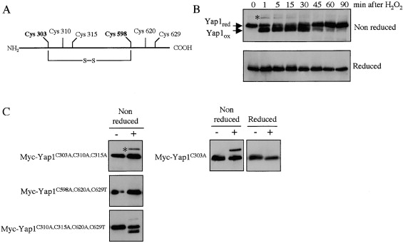
Sensing - processes occurring in yeast

Slide 12
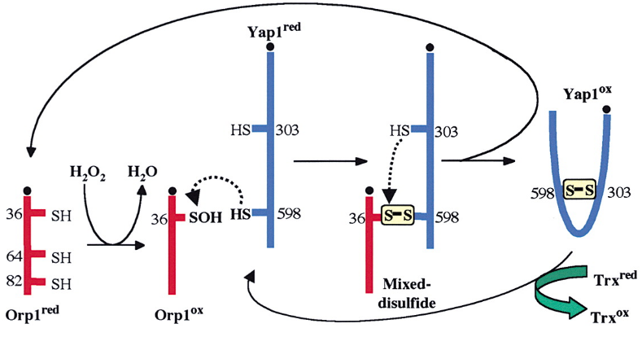
Sensing - processes occurring in yeast

Slide 13
Sensing - For Us
How can we acquire these data?

Slide 14
Sensing - For Us
Accurate determination of subcellular metabolite concentrations is a challenging task:
disruption of organelles or transporter activities may alter the metabolite distribution during sample preparation
instability (particularly of redox states) following tissue disruption.
Nonaqueous(非水溶液) extraction of organelles from tissue or very rapid fractionation of protoplasts (within seconds) can minimize these problems. More recent approaches have involved in situ labeling with specific antibodies for ascorbate and glutathione.

Slide 15
Sensing - For Us: H2O2
there is little reliable information available in the literature on concentrations in different compartments
Data in the table(other than the vacuole&apoplast) infered by the affinities of the major H2O2-removing peroxidases, known inhibition of important enzymes by H2O2 and so on.
The vacuolar concentration is estimated assuming that H2O2 will result mainly from movement from the cytosol without active transport, tending to equilibrium on both sides of the tonoplast.
We infer the high concentrations in the apoplast based on the presence of numerous ROS-producing systems, a relatively weak antioxidative system, and the need to account for reported values of H2O2.

Slide 16
Sensing - Are You Serious?
Table refers largely to mesophyll(叶肉) cells and does not consider tissues such as the vasculature, where H2O2 concentrations remain poorly characterized.
Possible compartmentation of this type needs to be taken into account in assessing the relevance of H2O2 contents measured in whole tissue extracts.

Slide 17
Sensing - For Us: Probes
These newer probes offer sensitive and more reliable readouts but are difficult to apply to some tissues like leaves, and their specificity is still disputed.
Genetically encoded sensors such as the ratiometric HyPer and HyPerRed were also used for ROS and redox detection in previous studies.
A major advantage for future plant ROS research would be to standardize protocols for in vivo cell imaging.

Slide 18
How can a ROS make influence on signaling?
Production
Defense
Sensing
Transport
Et al.

Slide 19
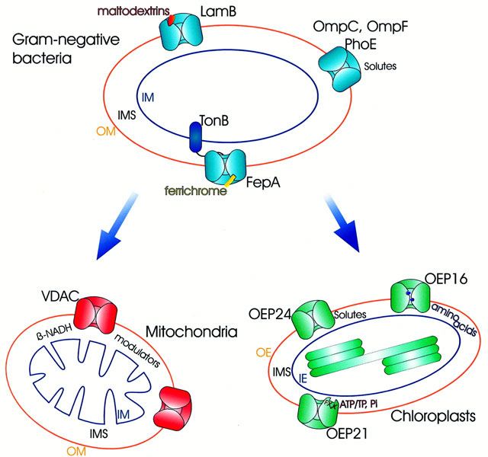
Transport - Chloroplast and Mitochondrial Outer Membranes
outer membrane pores - from bacteria to mitochondria and chloroplasts - as generally open non‐selective diffusion pores

Slide 20
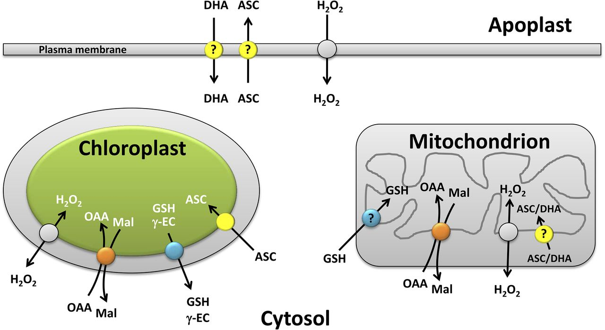
Transport - Inner Membranes

Slide 21
Transport - Inner Membranes
gray indicates aquaporin or other H2O2 transporter; In the case of chloroplasts, these aquaporins were shown to be crucial to the movement of CO2.
For glutathione:
which transporters may be involved in determining the redistribution of the disulfide form (oxidized glutathione [GSSG]) during oxidative stress.
For ascorbate:
systems have not yet been characterized that ensure ascorbate transport across the thylakoid membrane into the lumen to support violaxanthin deepoxidase activity and other biochemical functions.
NAD(P)-linked metabolites:
to ensure the exchange of redox equivalents at much more rapid rates than can occur through the direct transport of pyridine nucleotides, which are relatively large and highly charged metabolites.

Slide 22
Transport - Inner Membranes
Dicarboxylate transporters:
exchange redox equivalents as malate and oxaloacetate
The redox-regulated chloroplast NADP-malate dehydrogenase:
function together with chloroplast envelope dicarboxylate transporters to avoid overreduction in the stroma by transferring reducing equivalents to the cytosol (Scheibe et al., 2005).
the chloroplast envelope phosphate translocator:
exchange triose phosphate for phosphate as a chloroplast-cytosol carbon exporter or triose phosphate for 3-phosphoglycerate as a reductant (and ATP) exporter.

Slide 23
Transport - A difficulty
Plant aquaporins present on the plasma membrane and tonoplastassumed to play roles in H2O2 signaling or regulation, but these studies have mainly been done in heterologous systems, and a key outstanding question is the direction of net movement within plant cells.
Based on the ROS-producing capacities of chloroplasts, peroxisomes, and mitochondria, one might expect them to influence ROS movement as net exporters. However, these organelles also house highly active antioxidative enzymes, meaning that they also could function as ROS sinks.

Slide 24
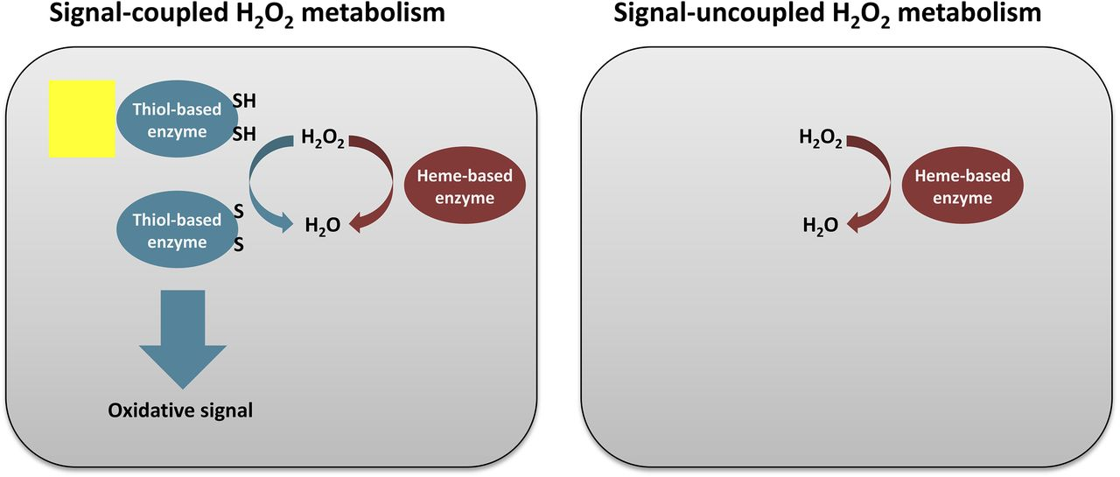
Transport - Thoils!!!

Slide 25
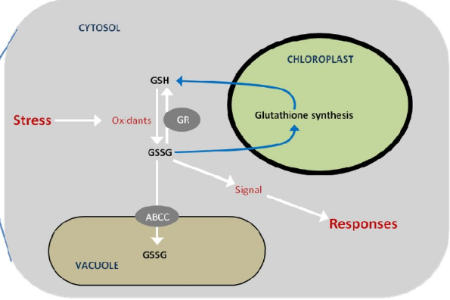
Transport - Thoils!!!

Slide 26
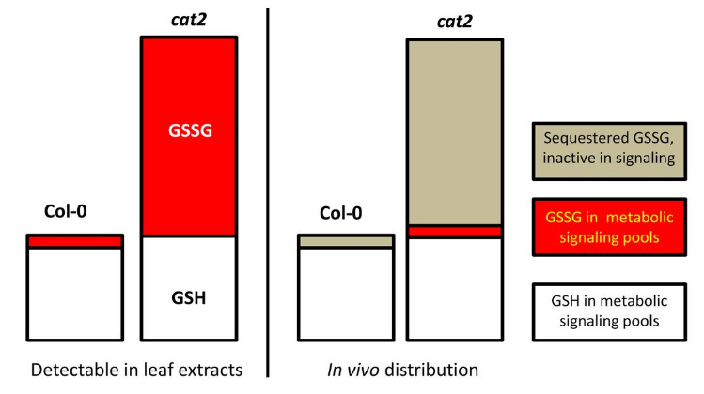
Transport - Thoils!!!

Slide 27
Transport
Many of the transporters remain to be characterized at the molecular level.
Example:
Yoshinori Moriyama and colleagues identify a member of the phosphate transporter 4 family, AtPHT4.4, that acts as an ascorbate transporter in the chloroplast envelope membrane of Arabidopsis thaliana3

Slide 28
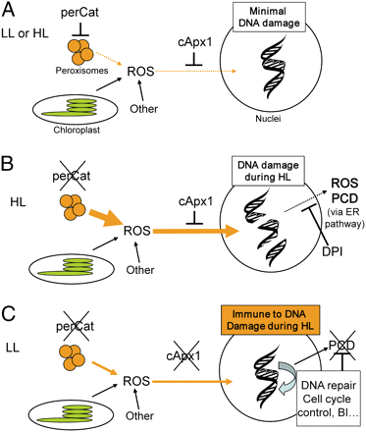
Transport - Intergration in Cytosol
The cytosol is much more than a buffer zone between the organelles and the nucleus, particularly since post-translational modifications of the translational apparatus allow very fast and highly effective control of protein synthesis.
As defined before;
As showed in the figure.

Slide 29
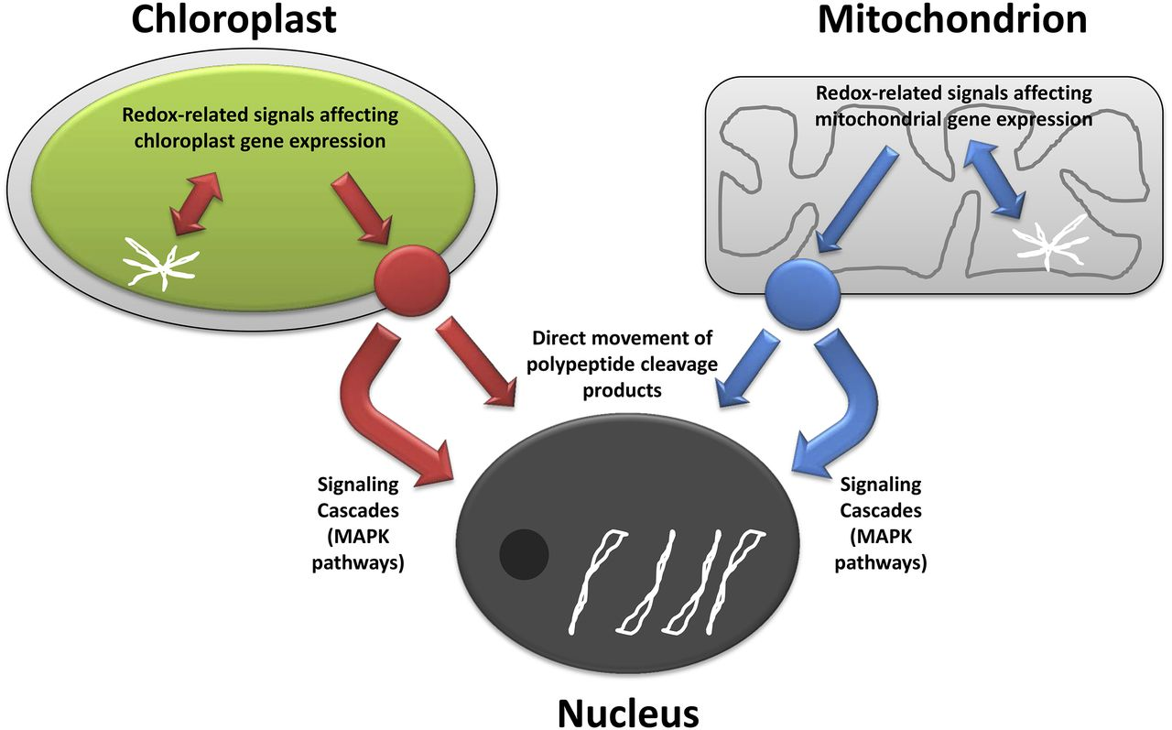
Transport - Toward Nucleus

Slide 30
Transport - Organellar Extensions
The transport of ROS or related compounds from organelles could theoretically transmit signals to the exterior, while the short lifetimes of ROS may limit the effectiveness.
Chloroplasts, mitochondria, and peroxisomes can produce extensions in the form of fluid-filled tubules that contain the soluble components of the compartments. These structures are known as stromules (chloroplasts), matrixules (mitochondria), and peroxules (peroxisomes).

Slide 31
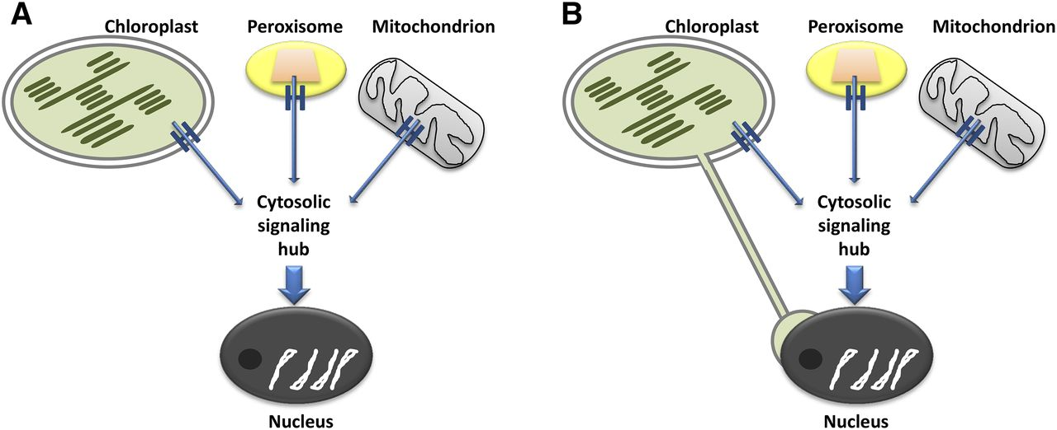
Transport - Organellar Extensions

Slide 32
Transport - Vesicles
Chloroplasts produce a number of different types of vesicles that have been implicated in the degradation of stromal proteins, but they also could carry metabolites such as ROS or other redox-active compounds like chlorophyll catabolites.
Moreover, the formation of ROS-containing vesicles has been documented at the plasma membrane during biotic stress and in the vesicular trafficking system during stresses such as high salt.

Slide 33
How can a ROS make influence on signaling?
Production
Defense
Sensing
Transport
Et al.

Slide 34
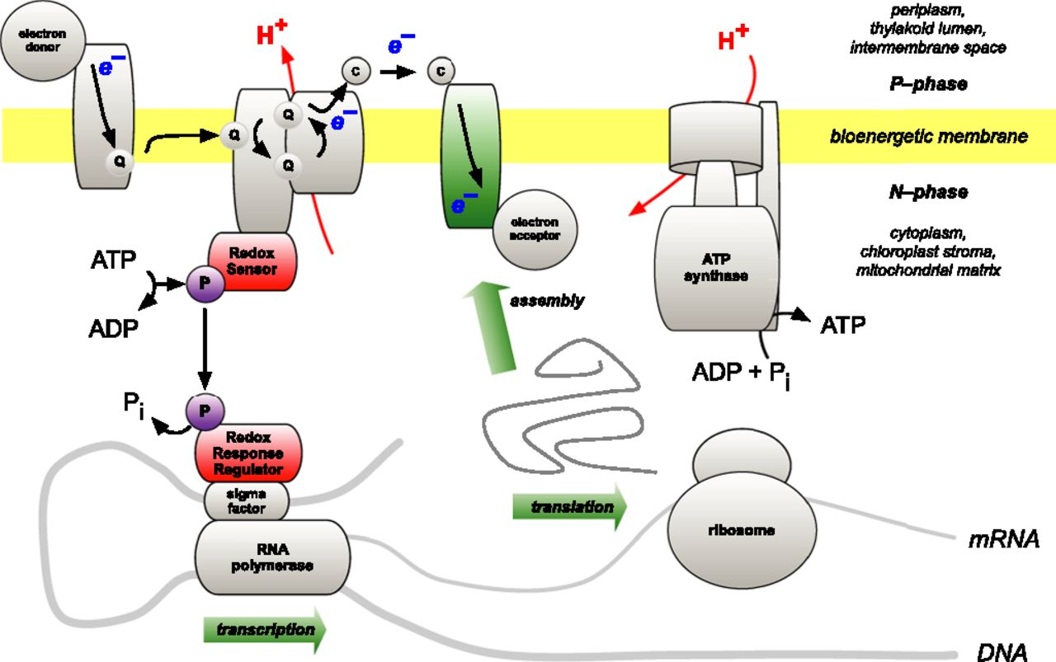
Local Regulation

Slide 35
Local Regulation
What accounts for the retention of genes for the complete synthesis within chloroplasts and mitochondria of a tiny minority of their protein subunits?
One hypothesis is that expression of genes for protein subunits of energy-transducing enzymes must respond to physical environmental change by means of a direct and unconditional regulatory control - change in the redox state.

Slide 36
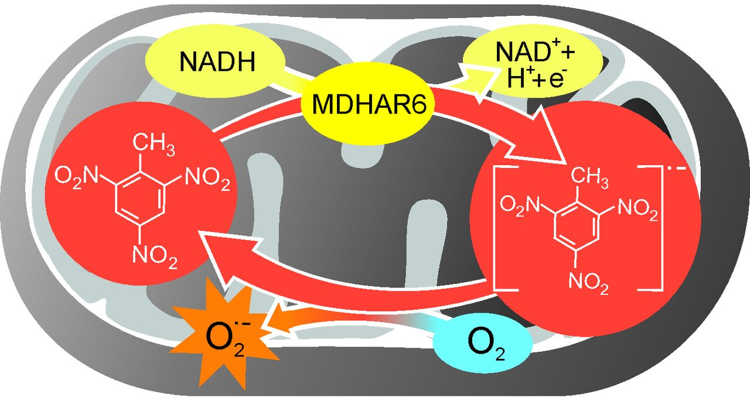
Antioxidant Enzymes May Have Pro-oxidant Roles Under Some Conditions

Slide 37
Spatial Range and Temporal Scale
Many ROS-dependent events occur on a longer time scale. In this respect, we can distinguish rapid ROS signaling that does not involve oxidative stress, perhaps occurring over seconds to minutes.
We suggest that signaling is commonplace but that accumulated damage is quite rare.
The cell houses a plethora of policing systems that scour the horizon for oxidatively modified proteins and either repair them or remove them.(include autophagy)

Slide 38
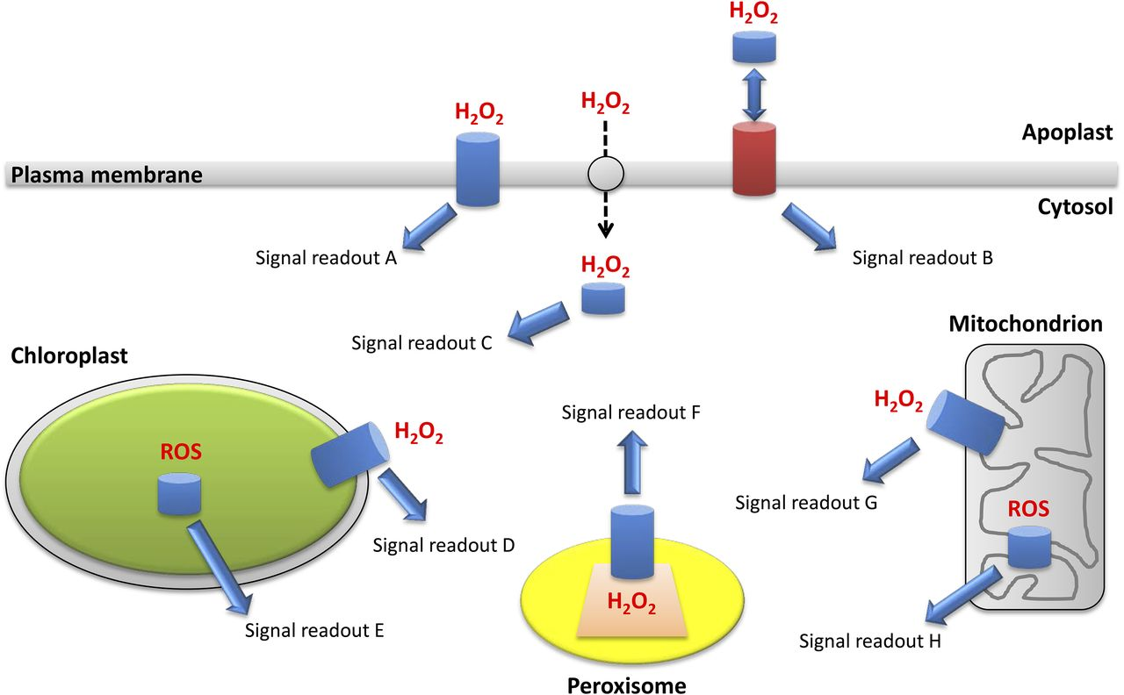
Conclusion?

Slide 39
Conclusion?
The central positioning of ROS signaling at the interface between metabolism and developmental or environmental responses.
Each location may have more than one type of receptor, and there may be intricate interplay between them. In this way, the ROS language could be rich in vocabulary with a well-defined grammar.

